Slide 1
pivot table data interpretation on marks distribution for education department
File created on: 12/12/2024 3:52:25 AM

Slide 2
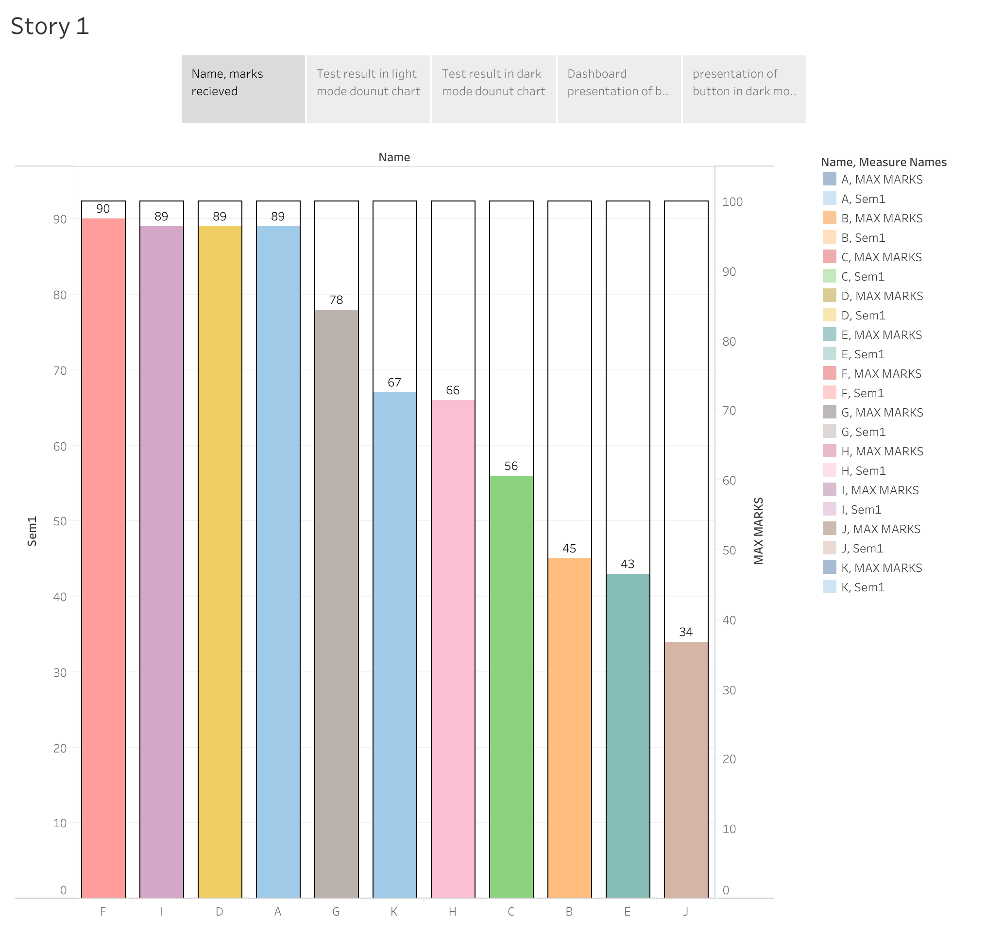

Slide 3
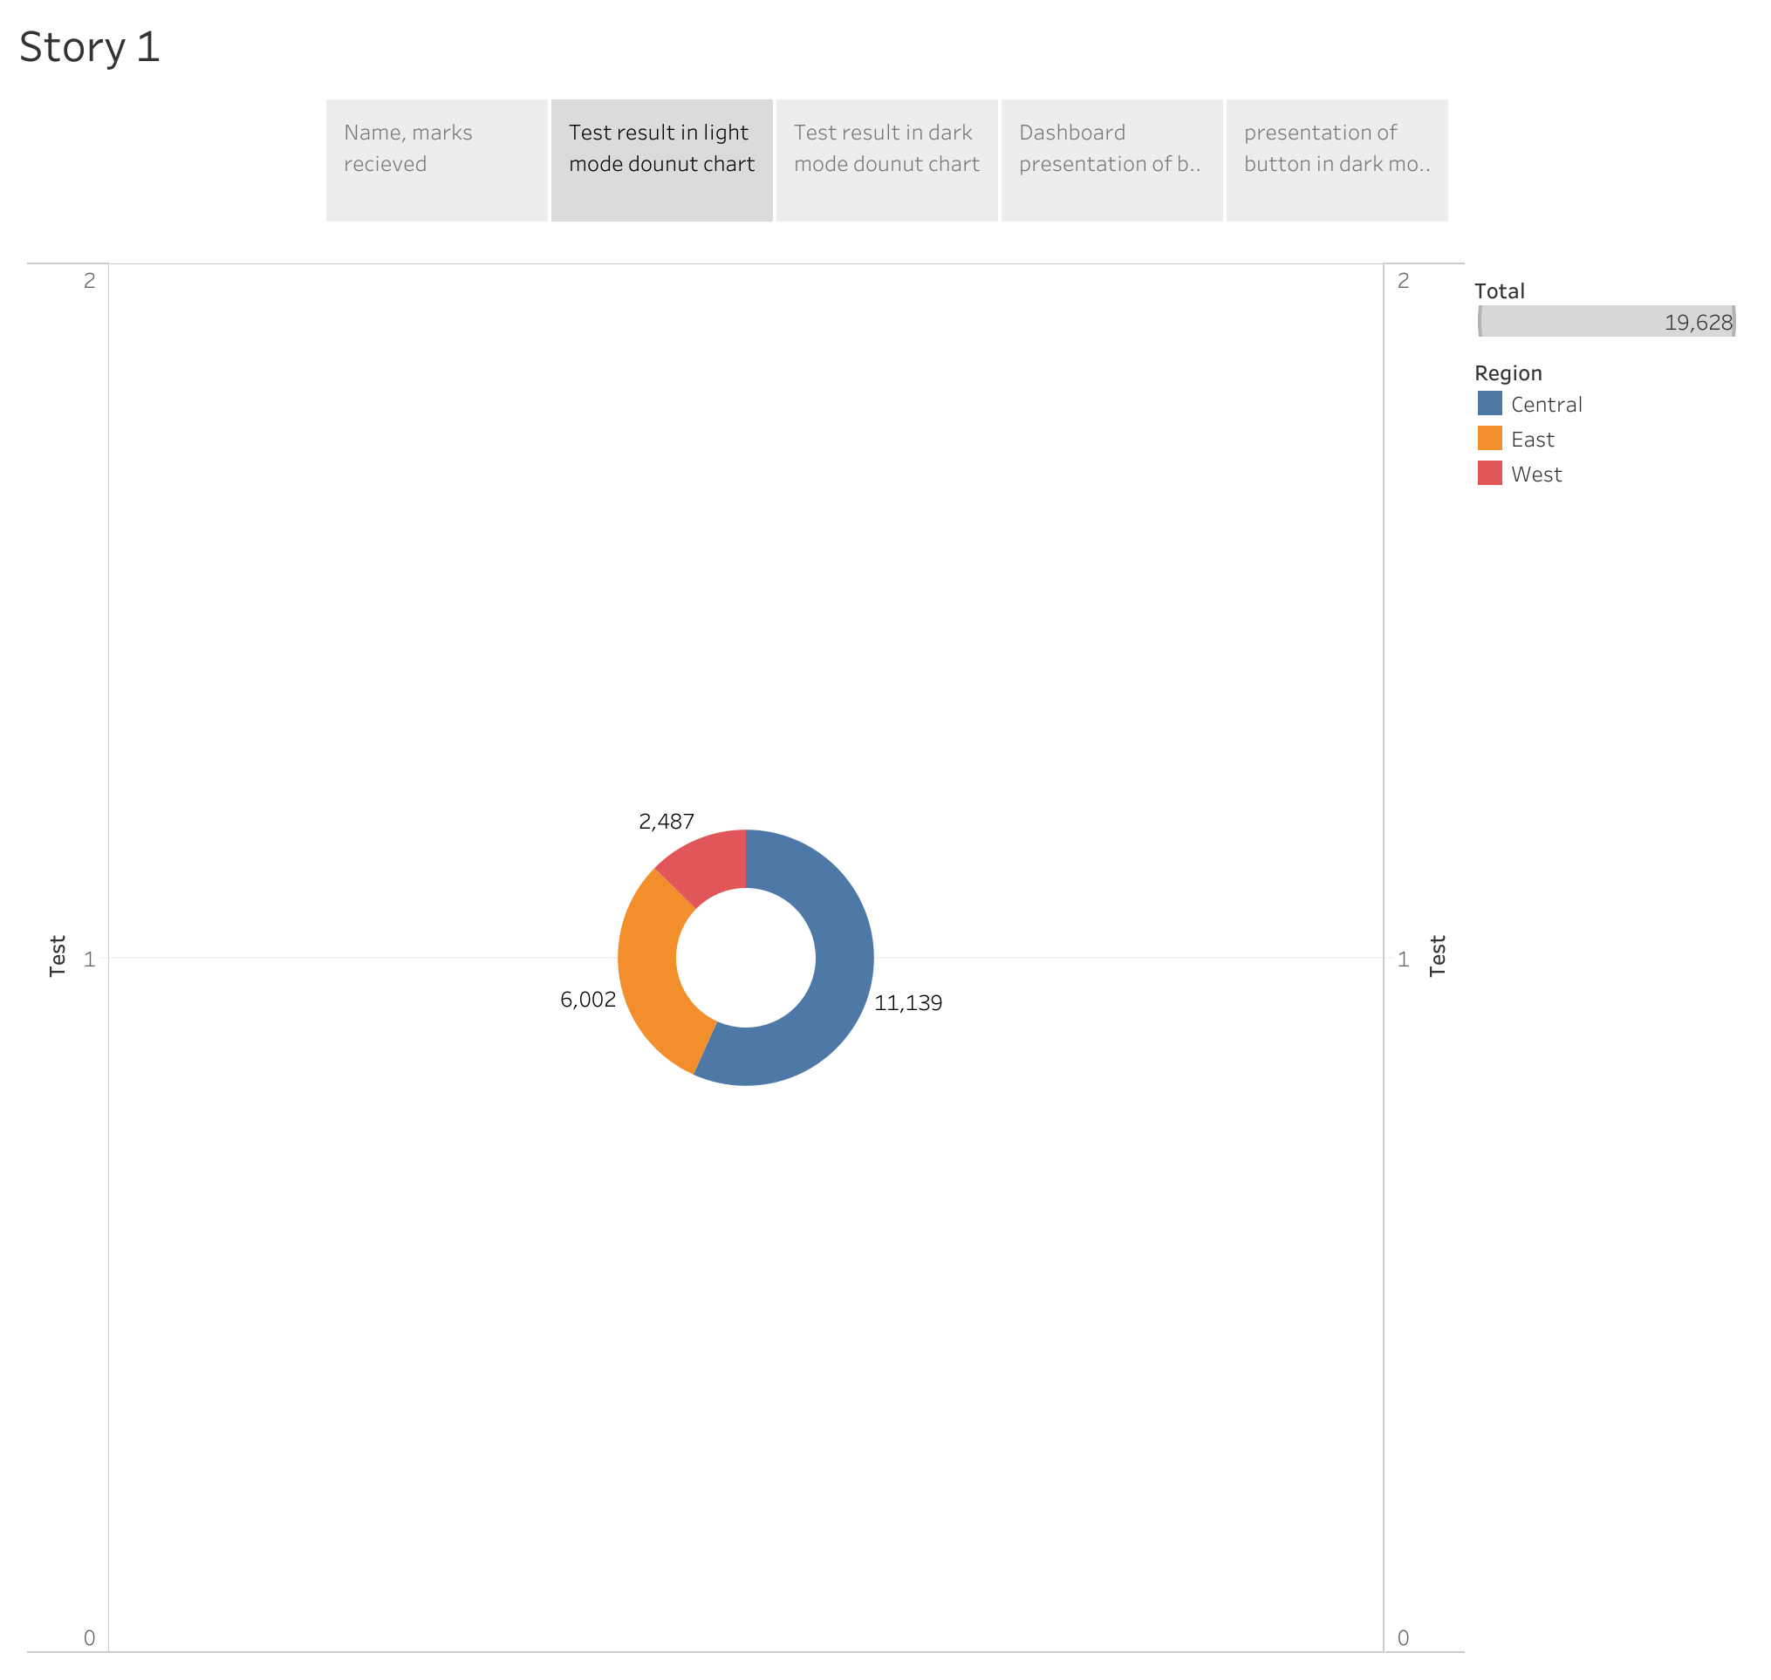

Slide 4
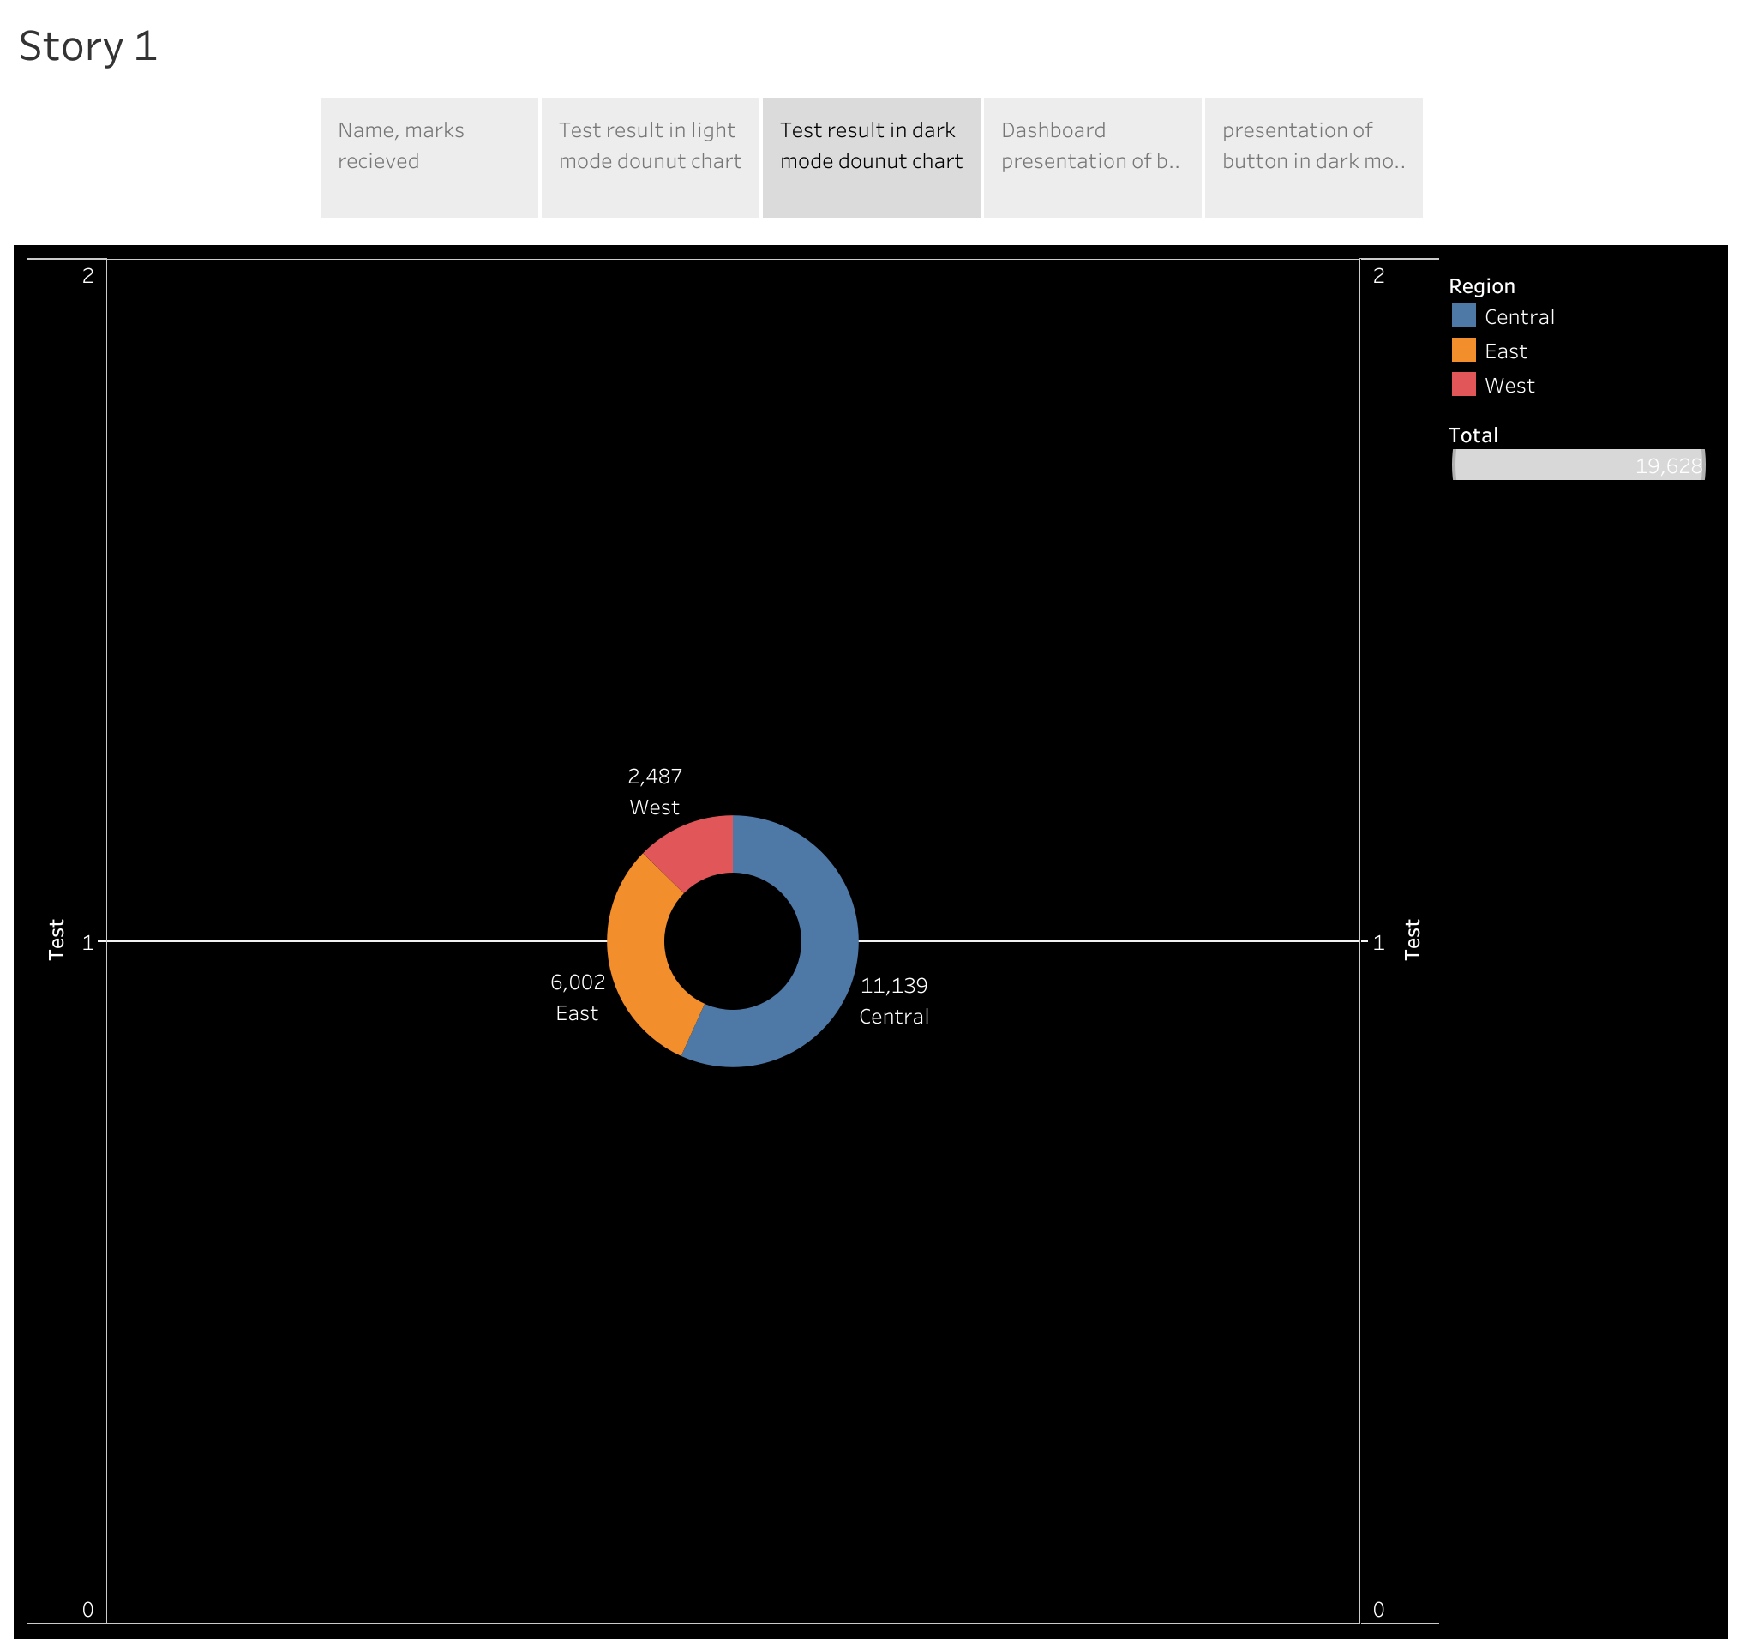

Slide 5
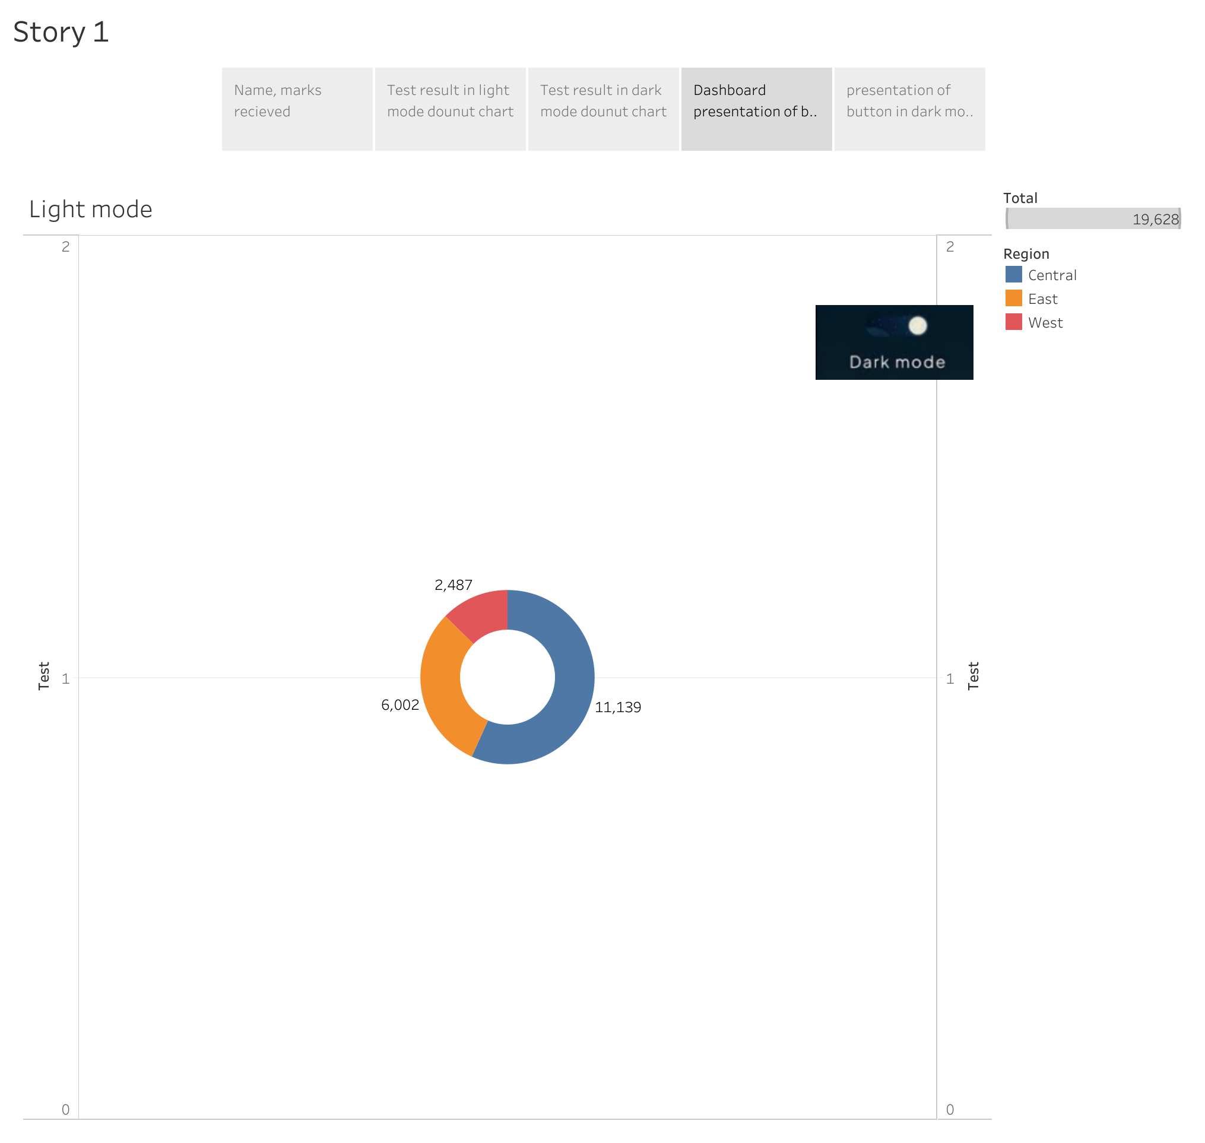

Slide 6
